Slide 1

Machine Learning Systems Design
Lecture 4: Model development & training
Zoom poll:
How do you feel about breakout exercises?
CS 329 | Chip Huyen

Slide 2
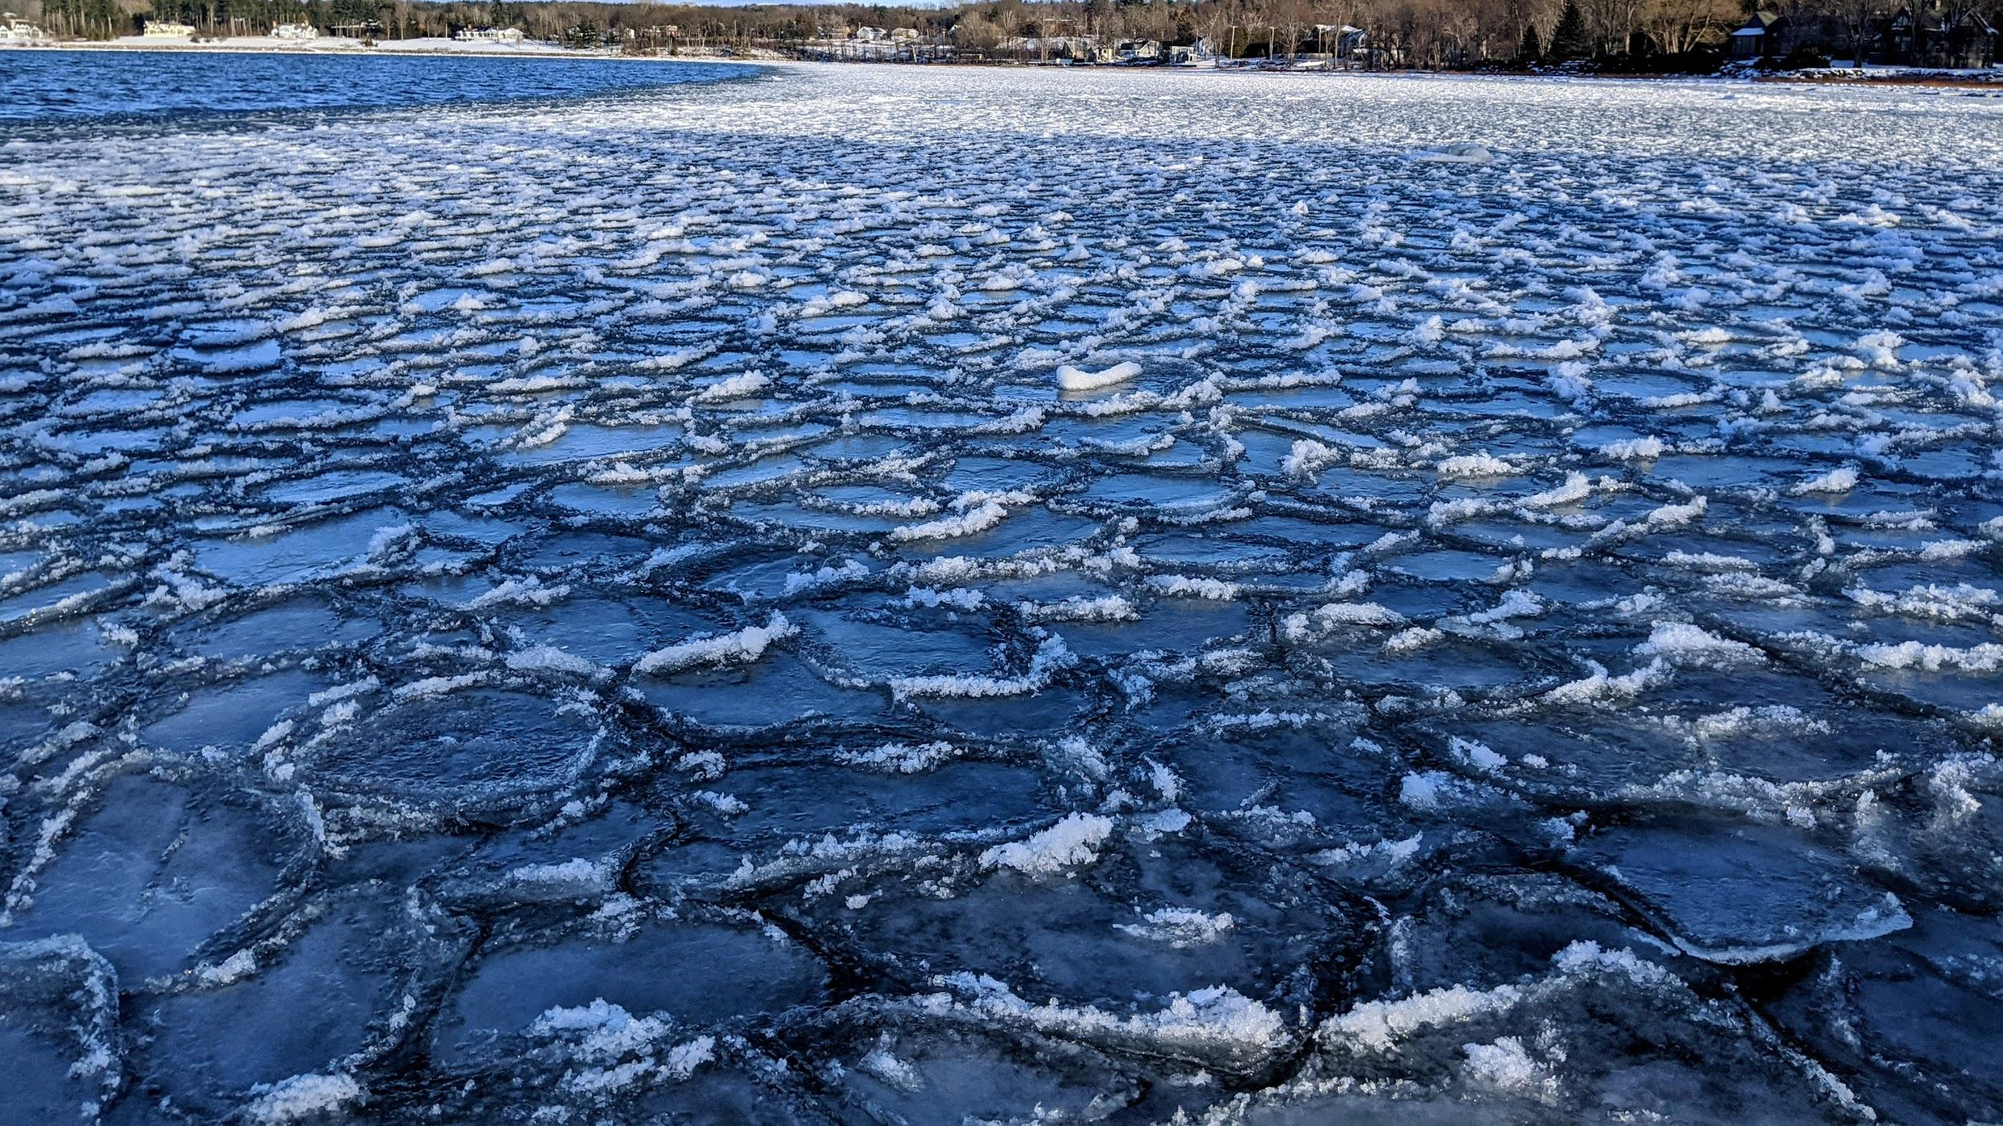
Waves + freezing temperature

Slide 3
Logistics
If you don’t have a team yet, search for a teammate now!
Project mentor sign-up sheet: sign-up now. Most slots are this Wed/Thu!
Assignment 1 due this Wednesday
Late policy:
Each student has 2 24-hour grace periods
Lecture notes 3 & 4 will be posted end of week

Slide 4
Agenda
Breakout exercise
Sampling
Class imbalance
Data augmentation
Feature engineering & data leakage
Model selection & training

Slide 5
Breakout exercise

Slide 6
Sampling exercise (group of 5, 7 minutes)
You want to build a model to classify whether a tweet spreads misinformation.
10M tweets from 10K users over the last 24 months
# tweets/user follows a long-tail distribution
You estimate 1% of tweets are misinformation
Questions:
How would you sample 100K tweets to label?
You get 100K labels from 20 annotators and want to look at some labels to estimate the quality.
How many labels would you look at?
How would you sample?
Imagine you have a stream of unknown number of tweets coming in, can’t fit all in memory. How to sample 10K tweets such that each tweet has an equal chance of being selected?

Slide 7
Sampling

Slide 8
Types of sampling
Non-probability sampling
Convenience sampling: selection based on availability
Soliciting response
Choosing existing datasets
Looking at available reviews on Amazon
Snowball sampling: future samples are selected based on existing samples
E.g. to scape legit Twitter accounts, start with seed accounts then scrape their following
Judgment sampling: experts decide what to include
Quota sampling: quotas for certain slices of data (no randomization)
....

Slide 9
Data used in ML is mostly driven by convenience
Language models: BookCorpus, CommonCrawl, Wikipedia, Reddit links
Sentiment analysis: IMDB, Amazon
Only users who have access to the Internet and are willing to put reviews online
Self-driving cars: most data is from the Bay Area (CA) and Phoenix (AZ)
Very little data on raining & snowing weather
⚠ Lots of biases in data! ⚠

Slide 10
Types of sampling
Non-probability sampling
Random sampling
Simple random sampling
Stratified sampling
Weighted sampling
Importance sampling
Reservoir sampling
...

Slide 11
Simple random sampling
Each sample in population has an equal chance of being selected
E.g. select 10% of all samples in population
Pros | Cons
Simple (easiest type of random sampling) | No representation guarantee: might exclude rare classes (black swan!)

Slide 12
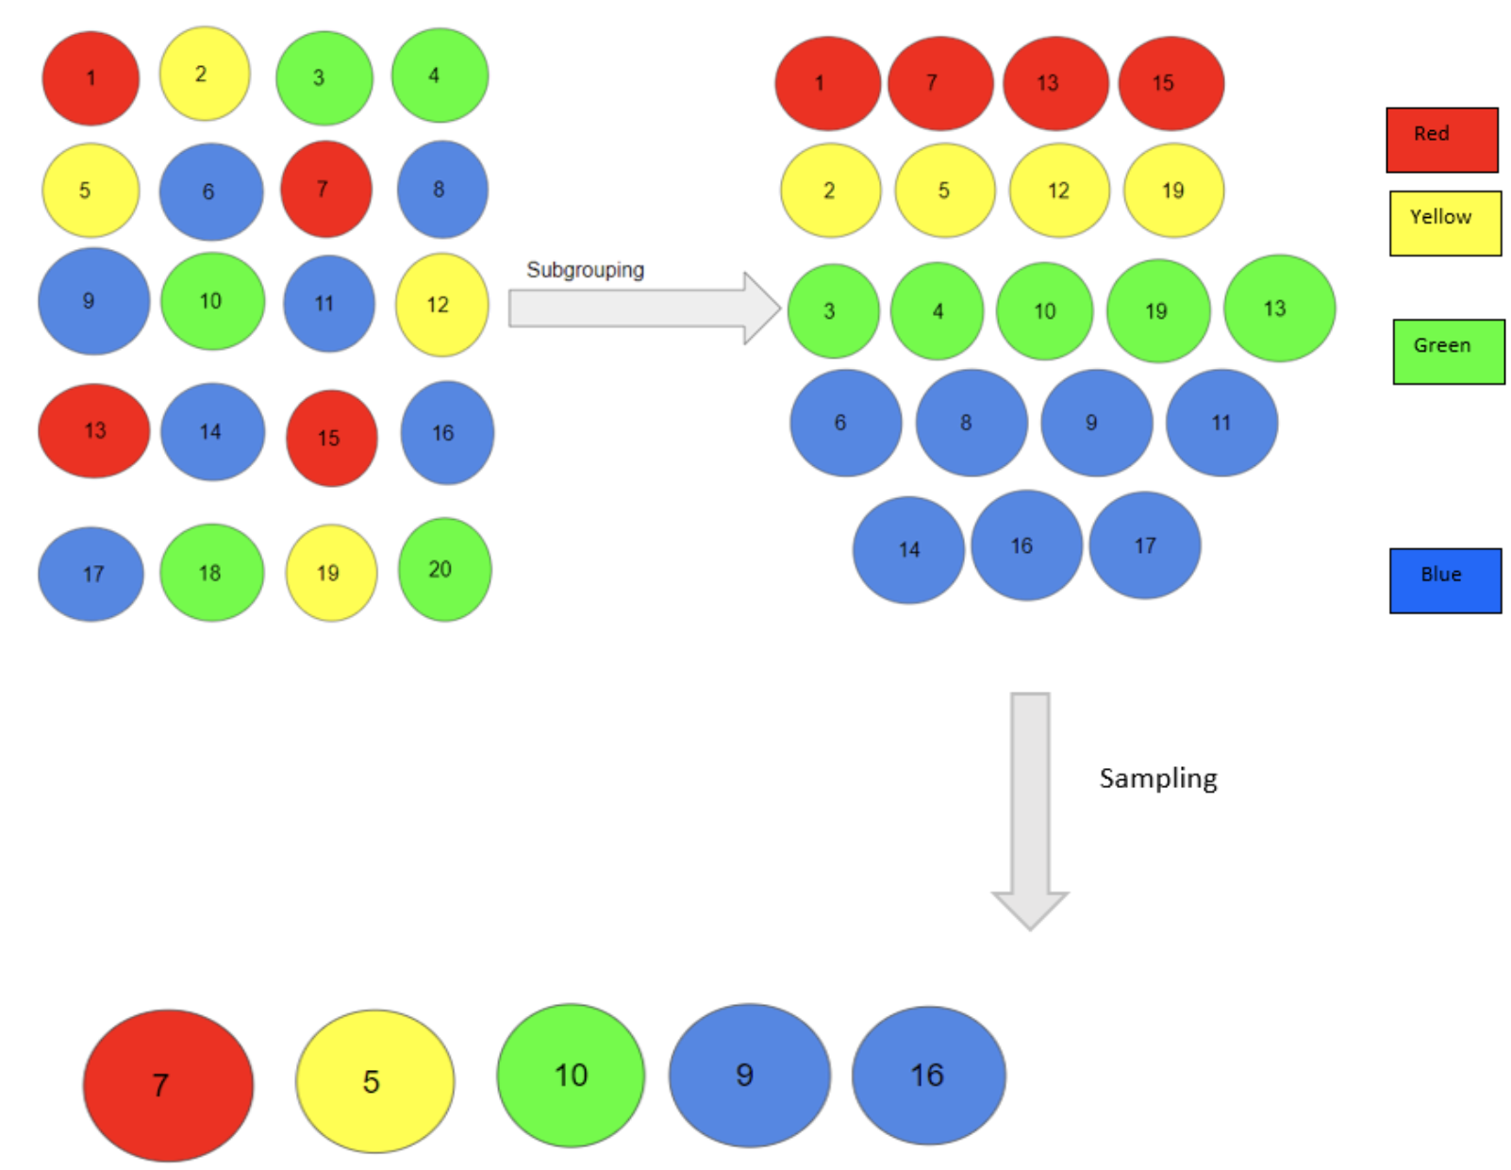
Stratified sampling
Divide population by subgroups
Slices of data
20% of each age group: 18-24, 25-34, 35+, etc.
Classes
2% of each class
Pros | Cons
Minor groups are represented | Can’t be used when: samples can’t be put into subgroups samples can belong in multiple subgroups (multilabel)
Image from https://www.analyticsvidhya.com/blog/2019/09/data-scientists-guide-8-types-of-sampling-techniques/

Slide 13
Weighted sampling
Each element is given a weight, which determines the probability of being selected.
If you want to select a sample 30% of the time, give it 3/10 weight
Might embed domain knowledge
E.g. know distribution of your target population or want to prioritize recent samples
random.choices(population=[1, 2, 3, 4, 100, 1000], weights=[0.2, 0.2, 0.2, 0.2, 0.1, 0.1],
k=2)
random.choices(population=[1, 1, 2, 2, 3, 3, 4, 4, 100, 1000],
k=2)

Slide 14
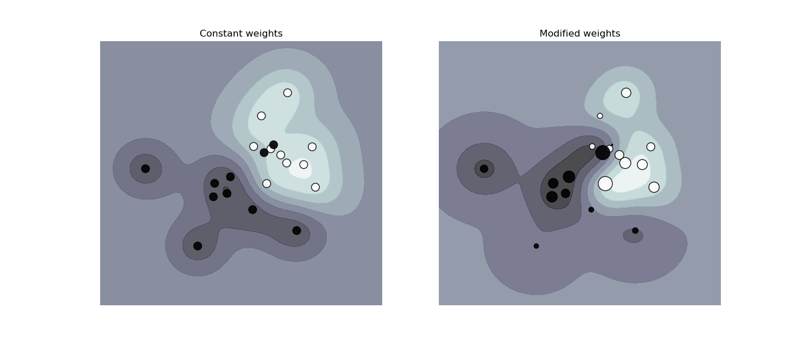
Weighted sampling -> sample weights
Each element is given a weight, which determines how much it affects the loss function.
E.g. give critical samples higher weight to punish wrong predictions on them more
Can modify decision boundaries
Image from https://scikit-learn.org/stable/auto_examples/svm/plot_weighted_samples.html

Slide 15
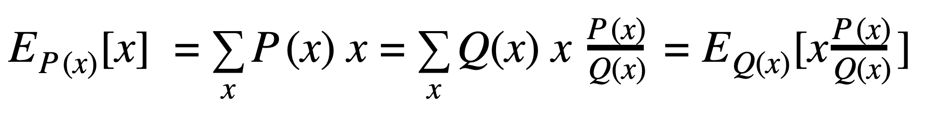
Importance sampling
Useful when sampling from P(x) is expensive, slow, or infeasible
Sample x 〜 Q(x) easier to sample from
Weight by P(x)/Q(x)
⚠ Calculating P(x)/Q(x) might be expensive ⚠

Slide 16
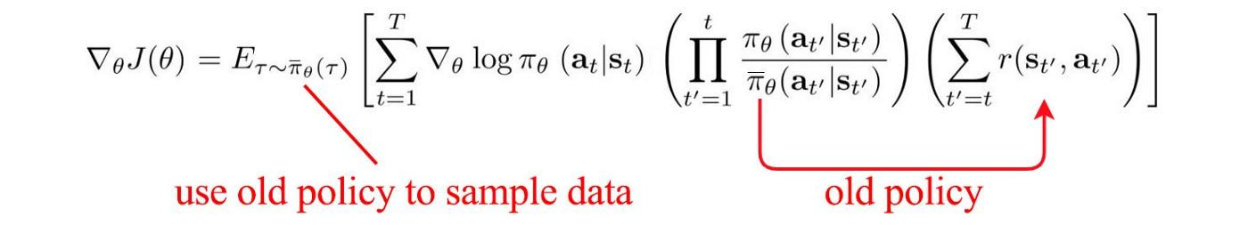
Importance sampling
Useful when sampling from P(x) is expensive, slow, or infeasible
Sample x 〜 Q(x) easier to sample from
Weight by P(x)/Q(x)
⚠ Calculating P(x)/Q(x) might be expensive ⚠
E.g. essential for RL
Too expensive to estimate reward under new policy, so use old policy

Slide 17
Reservoir sampling: problem
Need select k samples from a stream of n samples with equal probability
n is unknown
impossible/inefficient to fit all in memory
Can stop the stream any moment and get the required samples

Slide 18
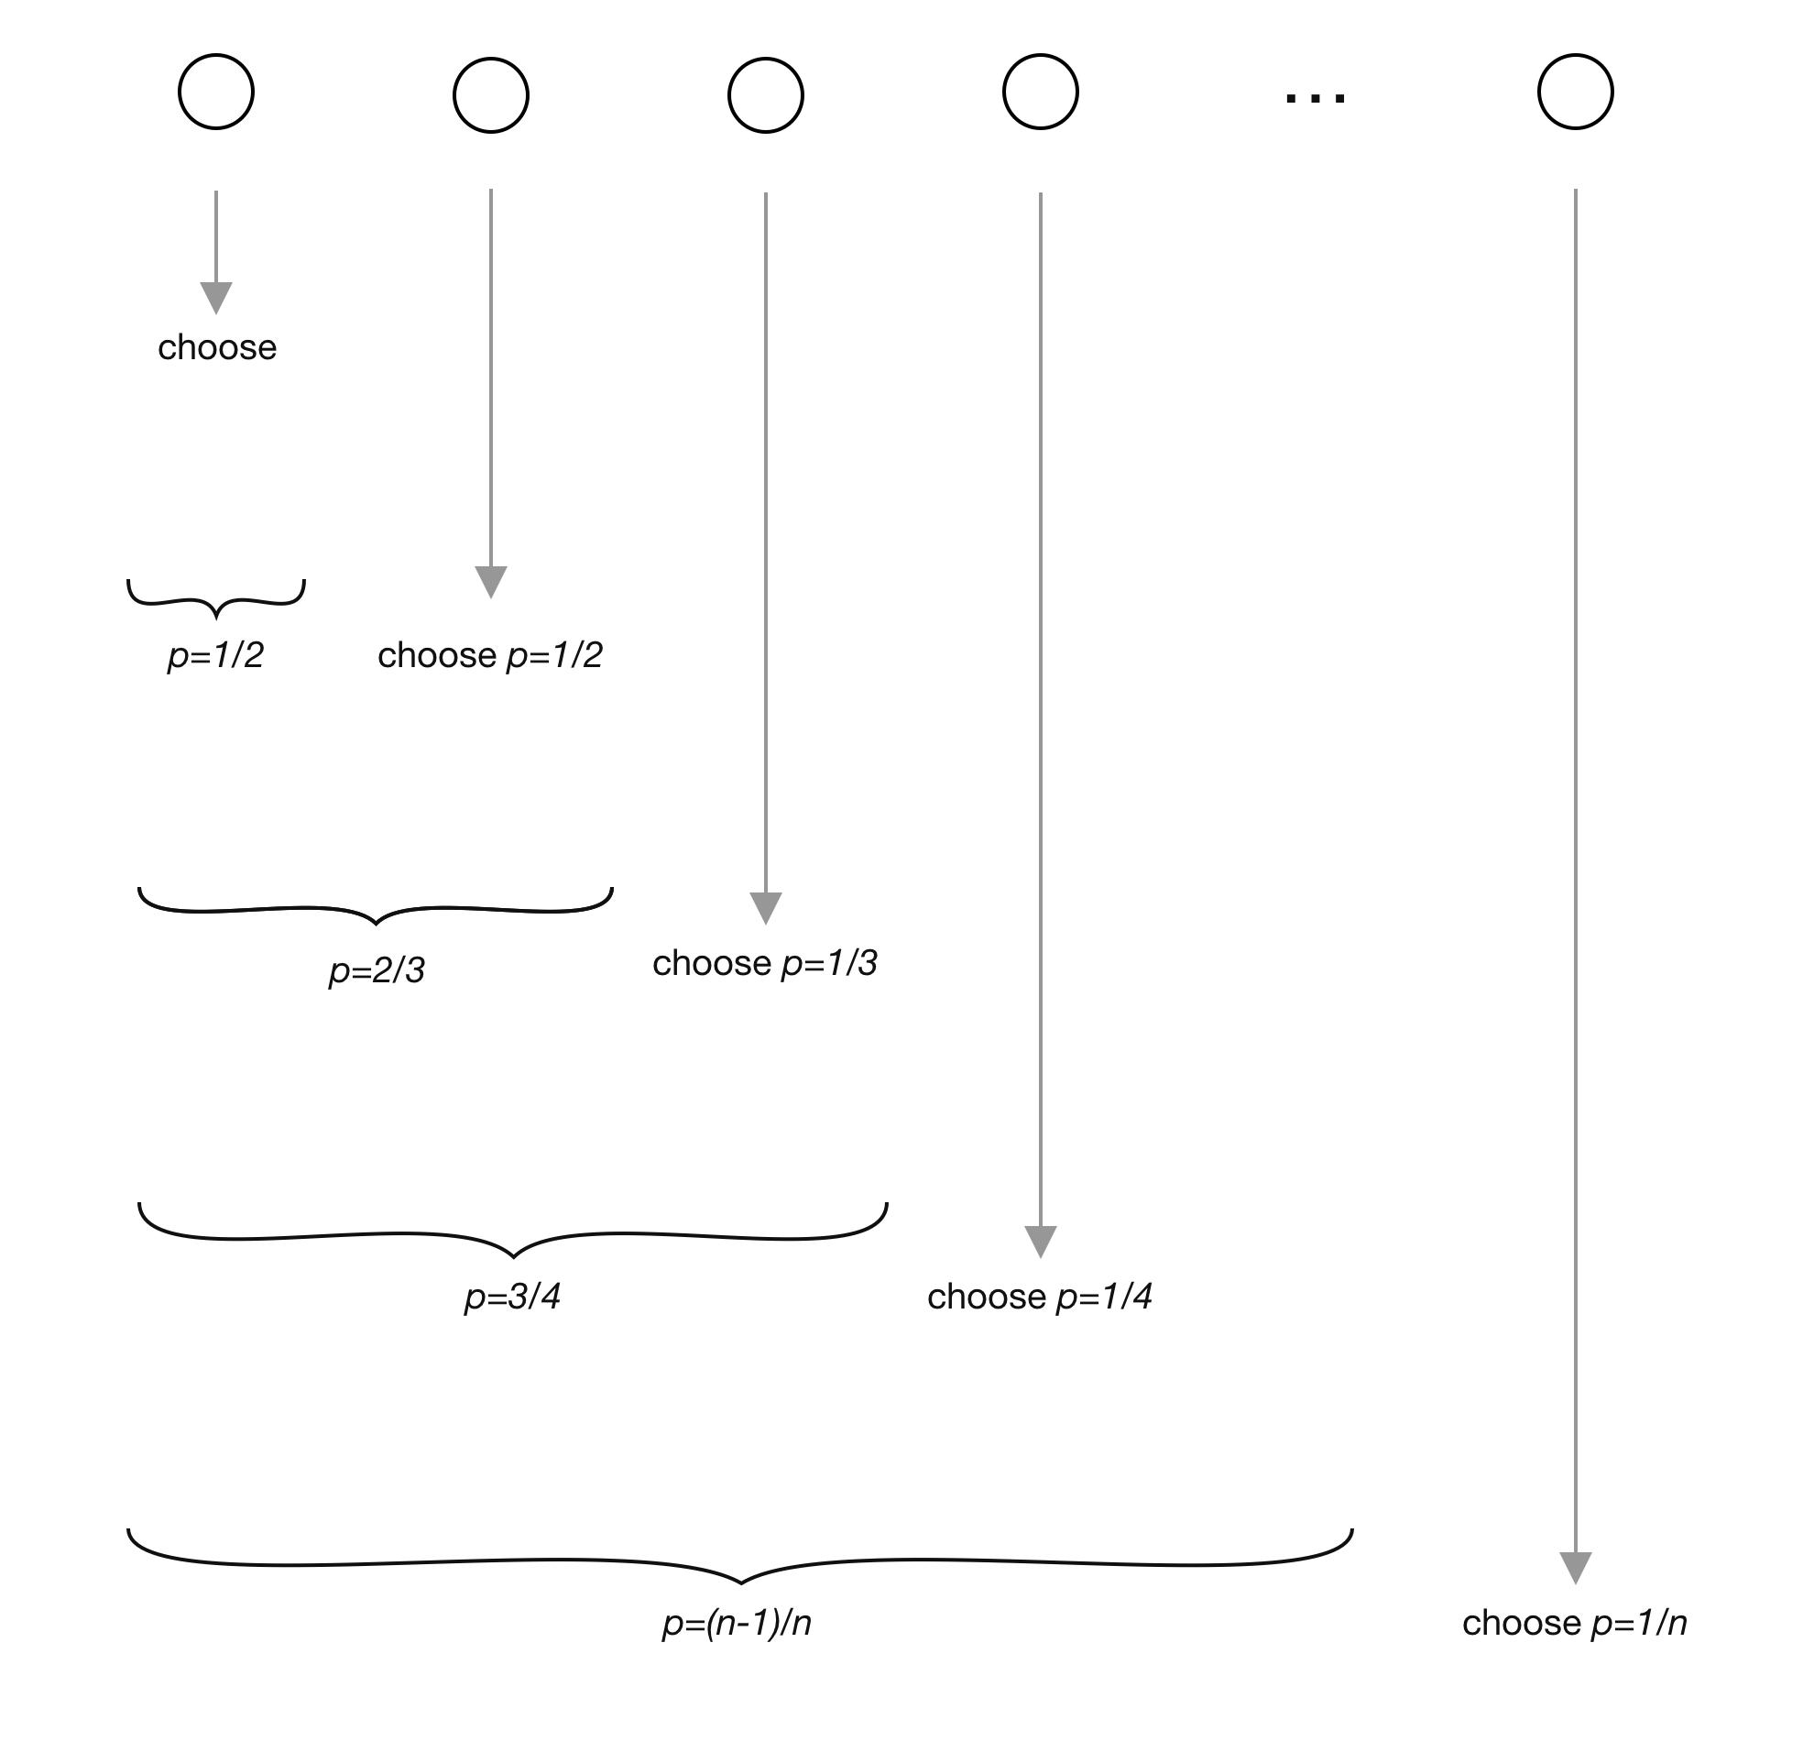
Reservoir sampling: solution
First k elements are put in reservoir
For each incoming i^{th} element, generate a random number j between 1 and i
If 1 ≤ j ≤ k: replace j^{th} in reservoir with i^{th}
Each incoming element has k/i chance of being in reservoir!
Also checkout algorithm L (based on geometric distribution)
Image from https://www.analyticsvidhya.com/blog/2019/09/data-scientists-guide-8-types-of-sampling-techniques/

Slide 19
With vs. without replacement
With replacement | Without replacement
Same item can be chosen more than once | Same item can’t be chosen more than once
No covariance between two chosen samples Approximate true population distribution | Covariance between two chosen samples Covariance reduced as dataset size becomes large
Bagging | Mini-batch gradient descent
Why do we use epochs instead of just sampling with replacement from the entire dataset?

Slide 20
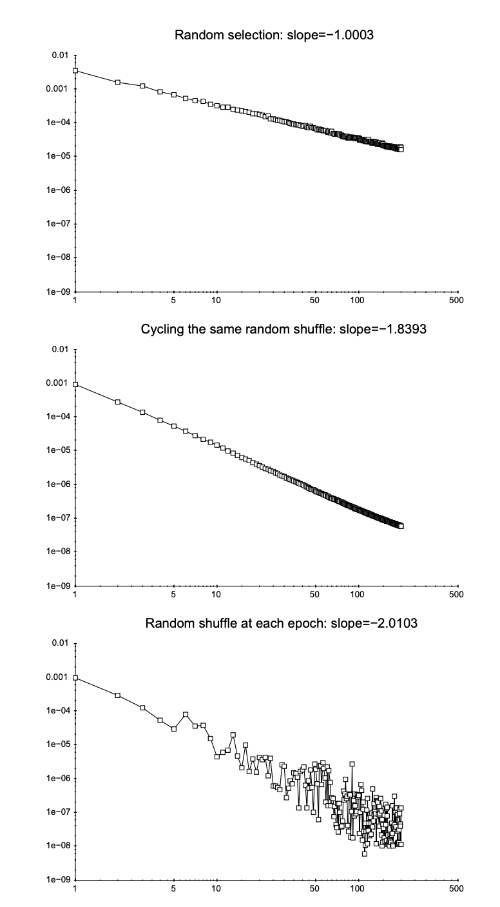
With vs. without replacements
Because empirically it’s converged faster (proven for strongly convex loss functions)
Curiously Fast Convergence of some Stochastic Gradient Descent Algorithms (Leon Bottou, 2009) Why Random Reshuffling Beats Stochastic Gradient Descent (Gurbuzbalaba et al., 2015)

Slide 21
Selection bias
Samples are chosen in a way that is not reflective of their real-world distribution.
Example:
Collecting IMDB reviews to estimate how good a movie is excludes all people who watch movies but don’t leave online reviews.

Slide 22
Class imbalance

Slide 23
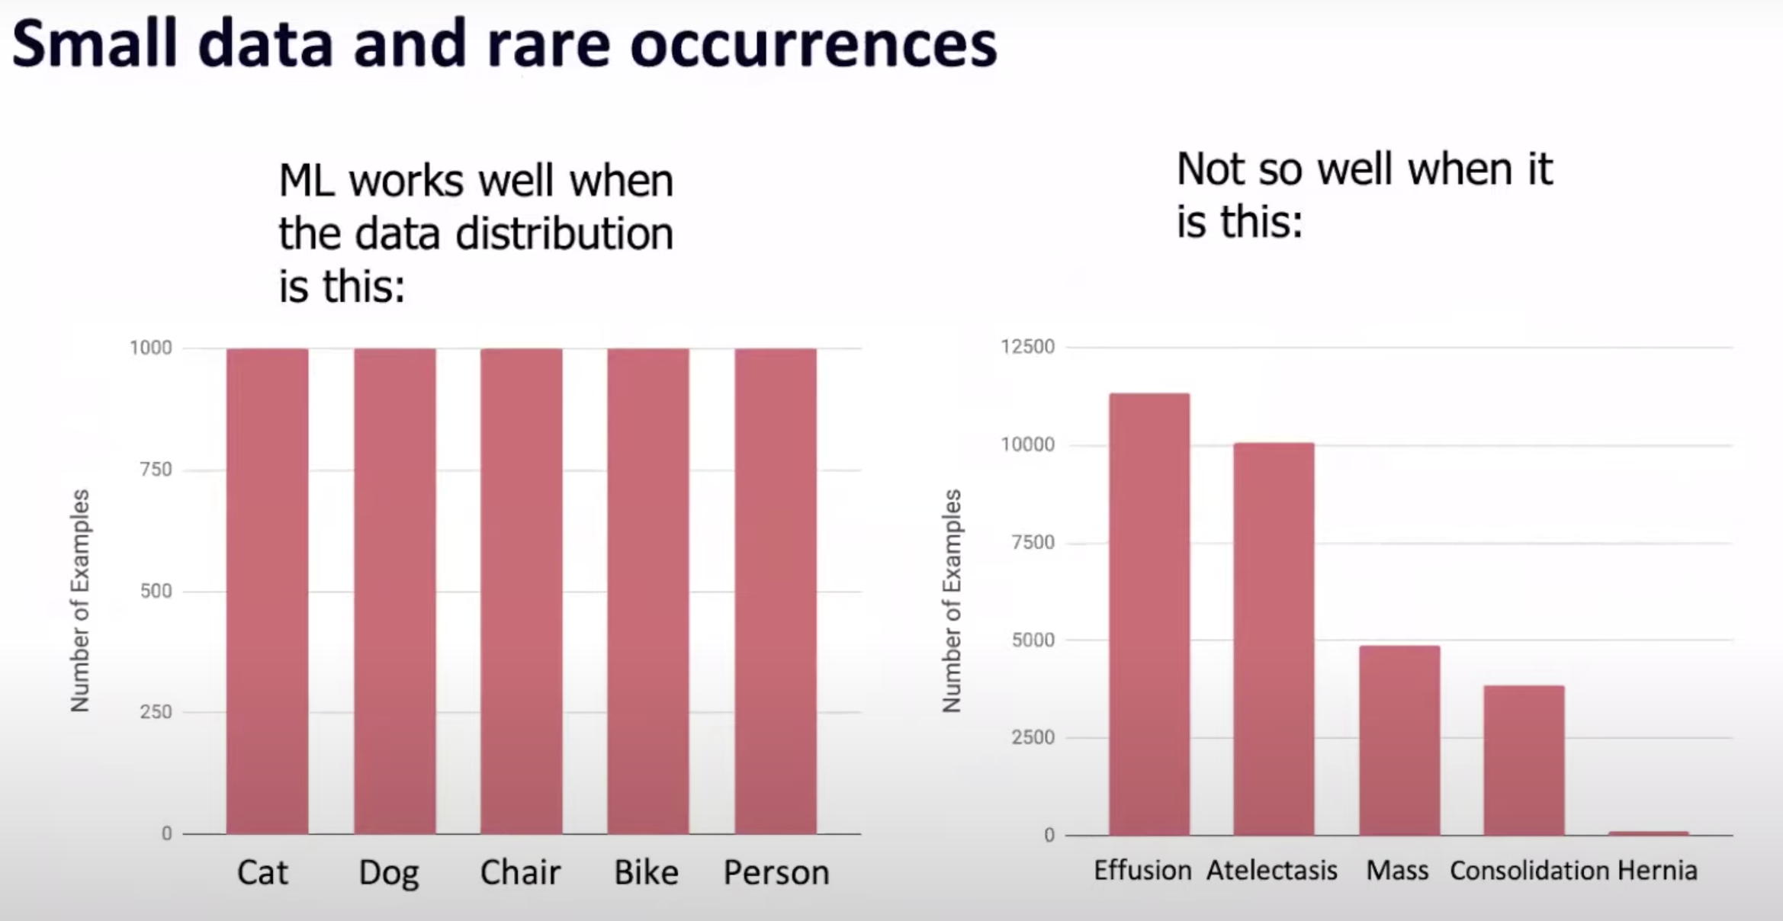
Class imbalance
https://www.youtube.com/watch?v=tsPuVAMaADY&ab_channel=StanfordHAI

Slide 24
Class imbalance
Why?
https://www.youtube.com/watch?v=tsPuVAMaADY&ab_channel=StanfordHAI

Slide 25
Why is class imbalance hard?
Not enough signal to learn about rare classes

Slide 26
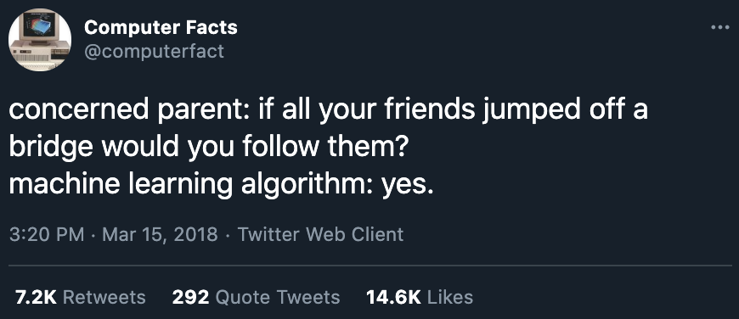
Why is class imbalance hard?
Not enough signal to learn about rare classes
Statistically speaking, predicting majority label has higher chance of being right
If a majority class accounts 99% of data, always predicting it gives 99% accuracy

Slide 27
Why is class imbalance hard?
Not enough signal to learn about rare classes
Statistically speaking, predicting majority label has higher chance of being right
Imbalance often comes with differences in cost of wrong predictions
Notes:
A reason why class imbalance is important

Slide 28
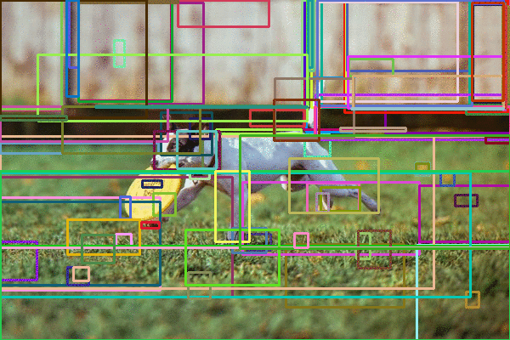
Class imbalance is the norm
Fraud detection
Spam detection
Disease screening
Churn prediction
Resume screening
E.g. 2% of resumes pass screening
Object detection
Most bounding boxes don’t contain any object
People are more interested in unusual/potentially catastrophic events
Image from PyImageSearch

Slide 29
Sources of class imbalance
Sampling biases
Narrow geographical areas (self-driving cars)
Selection biases
Domain specific
Costly, slow, or infeasible to collect data of certain classes
Labeling errors

Slide 30
How to deal with class imbalance
Add more minority samples or remove majority samples (resampling)
Adjust losses (weight balancing)
Choose algorithms robust to class imbalance

Slide 31

Class imbalance solution: Resampling
Undersampling | Oversampling
Remove samples from the majority class | Add more examples to the minority class
Can cause overfitting | Can cause loss of information
https://www.kaggle.com/rafjaa/resampling-strategies-for-imbalanced-datasets#t1

Slide 32
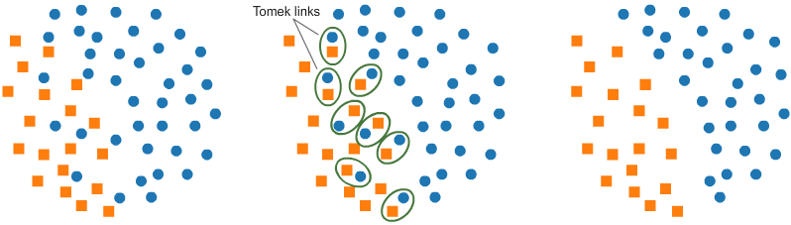
Undersampling: Tomek Links
Find pairs of close samples of opposite classes
Remove the sample of majority class in each pair
Pros: Make decision boundary more clear
Cons: Make model less robust
Image from https://www.kaggle.com/rafjaa/resampling-strategies-for-imbalanced-datasets

Slide 33
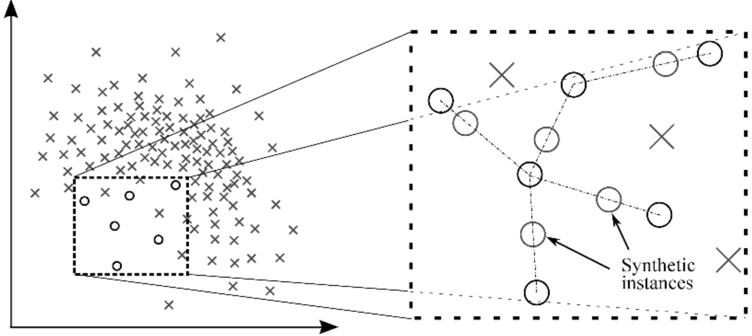
Oversampling: SMOTE
Synthesize samples of minority class as convex (〜linear) combinations of existing points and their nearest neighbors of same class.
Image from Analytics Vidhya

Slide 34
Oversampling: SMOTE
Both SMOTE and Tomek links only work on low-dimensional data!
Synthesize samples of minority class as convex (〜linear) combinations of existing points and their nearest neighbors of same class.
Image from Analytics Vidhya

Slide 35
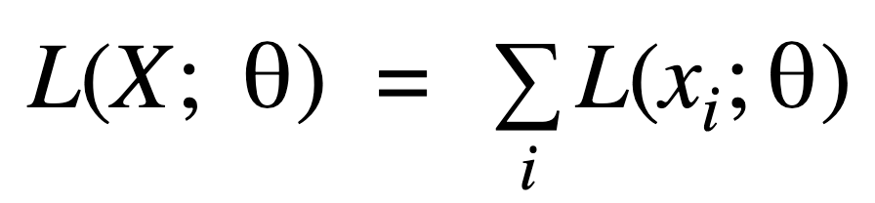
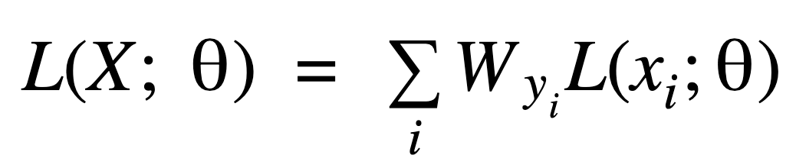
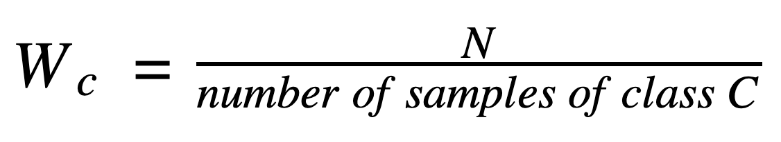
Class imbalance solution: weight balancing
Give more weight to rare classes
Non-weighted loss
Weighted loss
model.fit(features, labels, epochs=10, batch_size=32, class_weight={“fraud”: 0.9, “normal”: 0.1})
Notes:
Two techniques of weight balancing:
Give more weight to rare classes - then you incentivize the model to learn to classify them better.

Slide 36
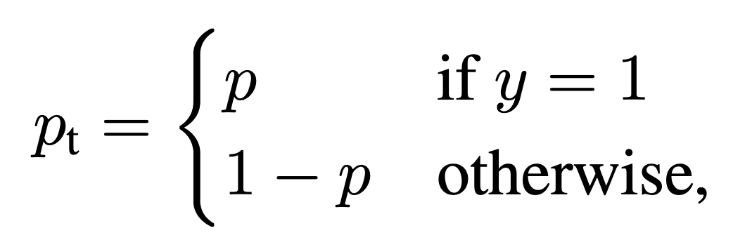
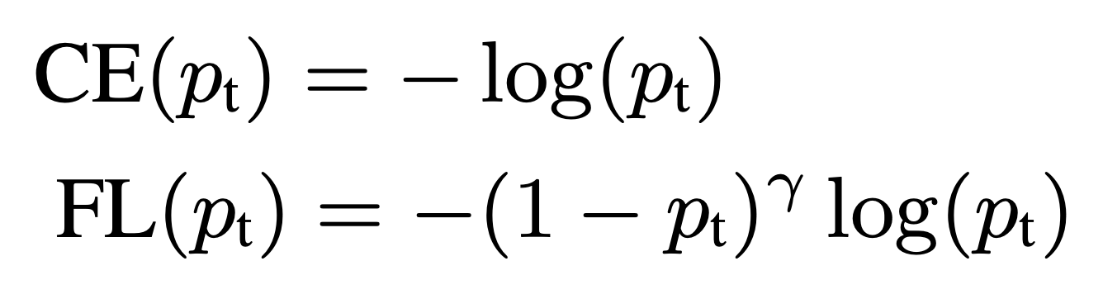
Class imbalance solution: weight balancing
Give more weight to rare classes
Give more weight to difficult samples:
downweighs well-classified samples
Focal Loss for Dense Object Detection (Lin et al., 2017)
Notes:
Give more weight to the examples that the model is having difficulty with.

Slide 37
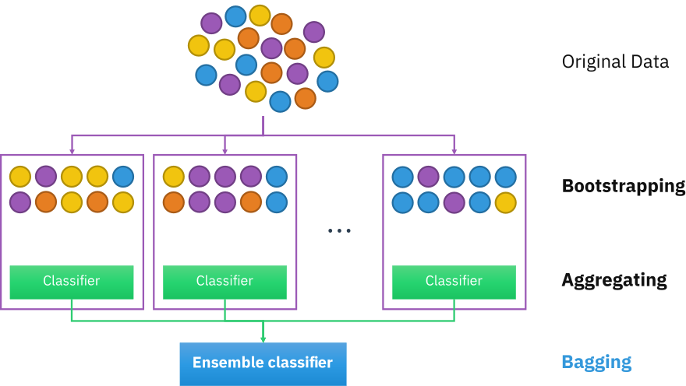
Class imbalance solution: algorithms
Sample with replacement to create different datasets
Train a classifier with each dataset
Aggregate predictions from classifiers
Illustration by Sirakorn

Slide 38
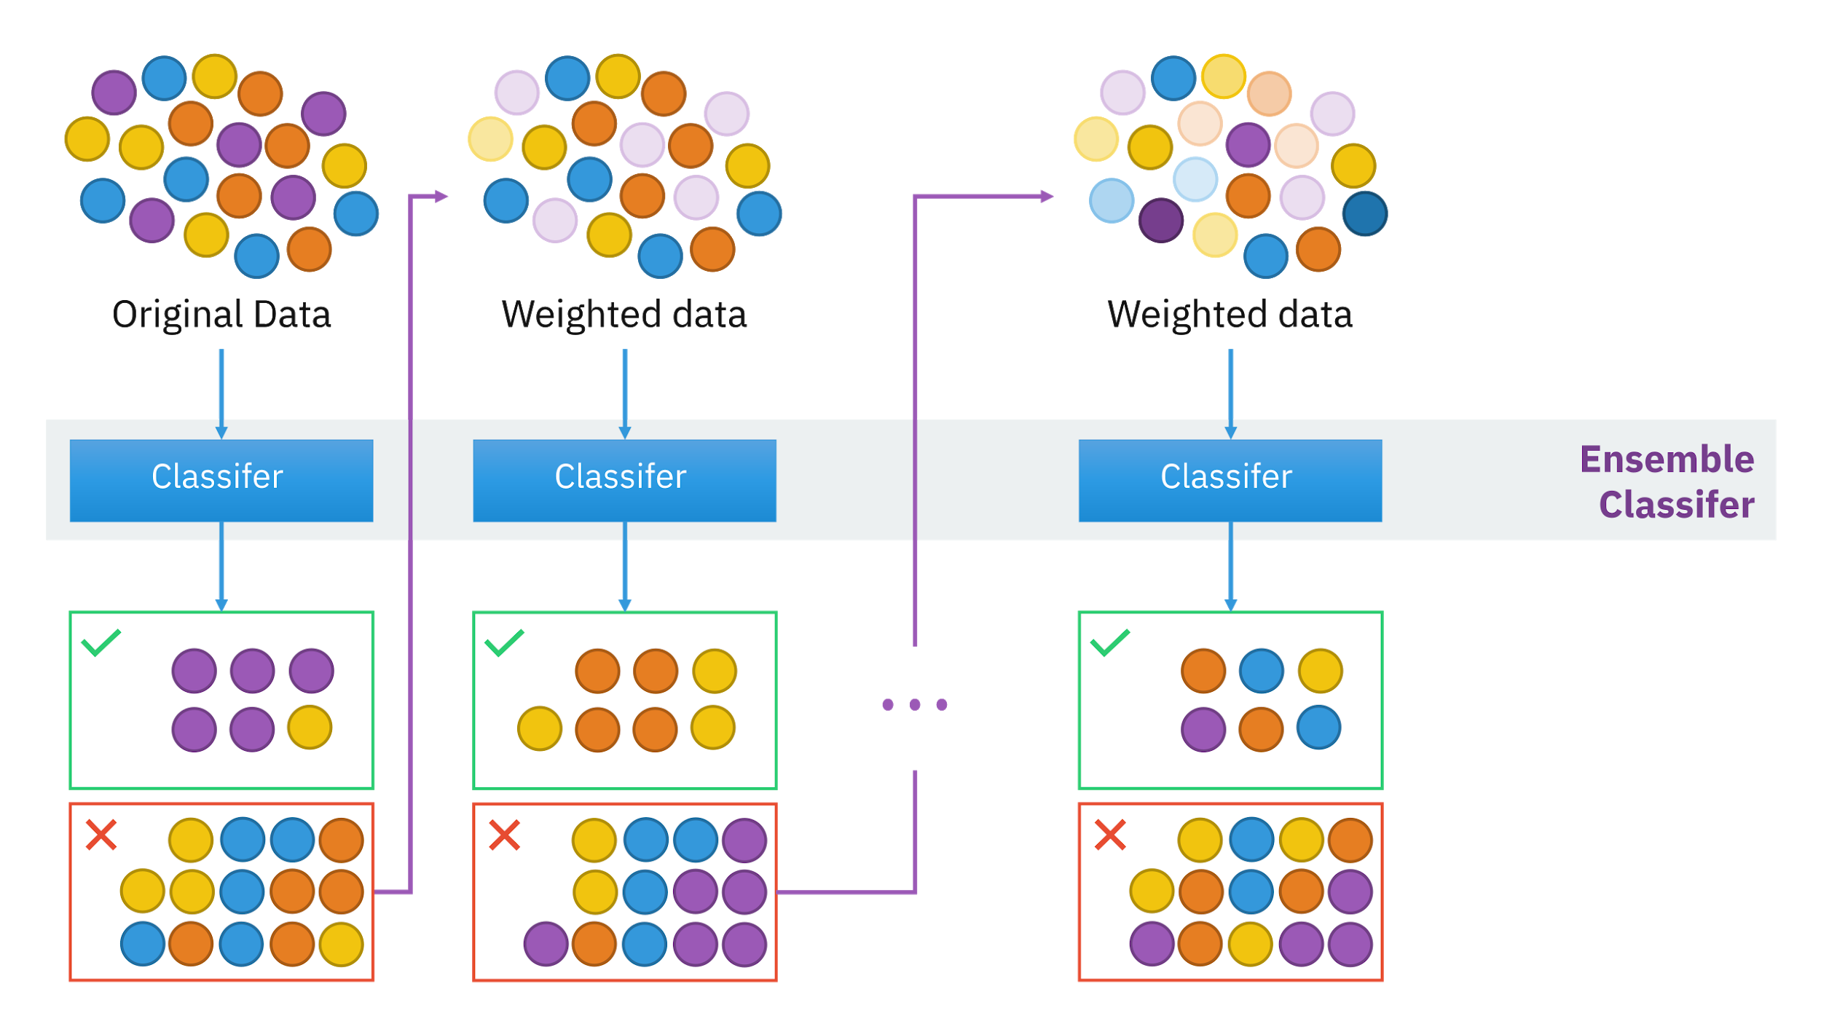
Class imbalance solution: algorithms
Train a weak classifier
Give samples misclassified by the weak classifier more weight
Repeat (1) on this reweighted data
Illustration by Sirakorn

Slide 39
Data augmentation

Slide 40
Data augmentation: goals
Improve model’s performance overall or on certain classes
Generalize better
Enforce certain behaviors

Slide 41
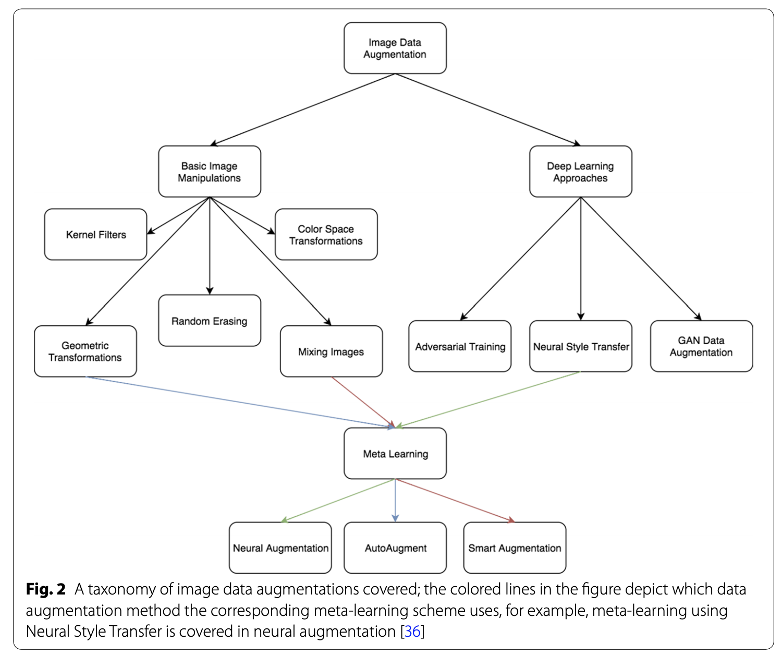
A survey on Image Data Augmentation for Deep Learning (Connor Shorten & Taghi M. Khoshgoftaar, 2019)

Slide 42
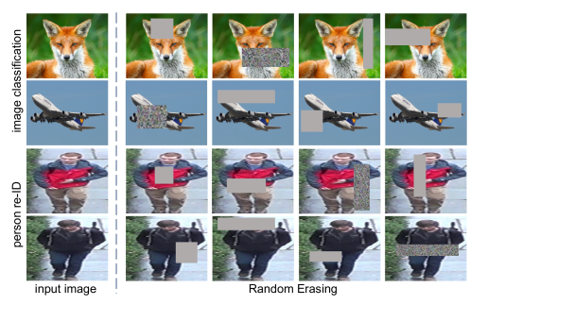
Data augmentation: image
Artificially enlarge the dataset using label-preserving image manipulations
random cropping, flipping, erasing
Random Erasing Data Augmentation (Zhong et al., 2017)

Slide 43
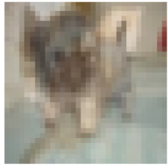
mixup
Create convex combination of samples of different classes
Original: image 1 - label 3 (cat), image 2 - label 4 (dog). All labels are discrete
Mixup: 70% dog, 30% cat - label 3.3
Incentivize models to learn linear relationships
Assumption: linear behaviour reduces the amount of undesirable oscillations when predicting outside the training examples
mixup: Beyond Empirical Risk Minimization (Zhang et al., 2017)

Slide 44
mixup
Improves generalization on speech and tabular data
Can be used to stabilize the training of GANs
https://forums.fast.ai/t/mixup-data-augmentation/22764

Slide 45
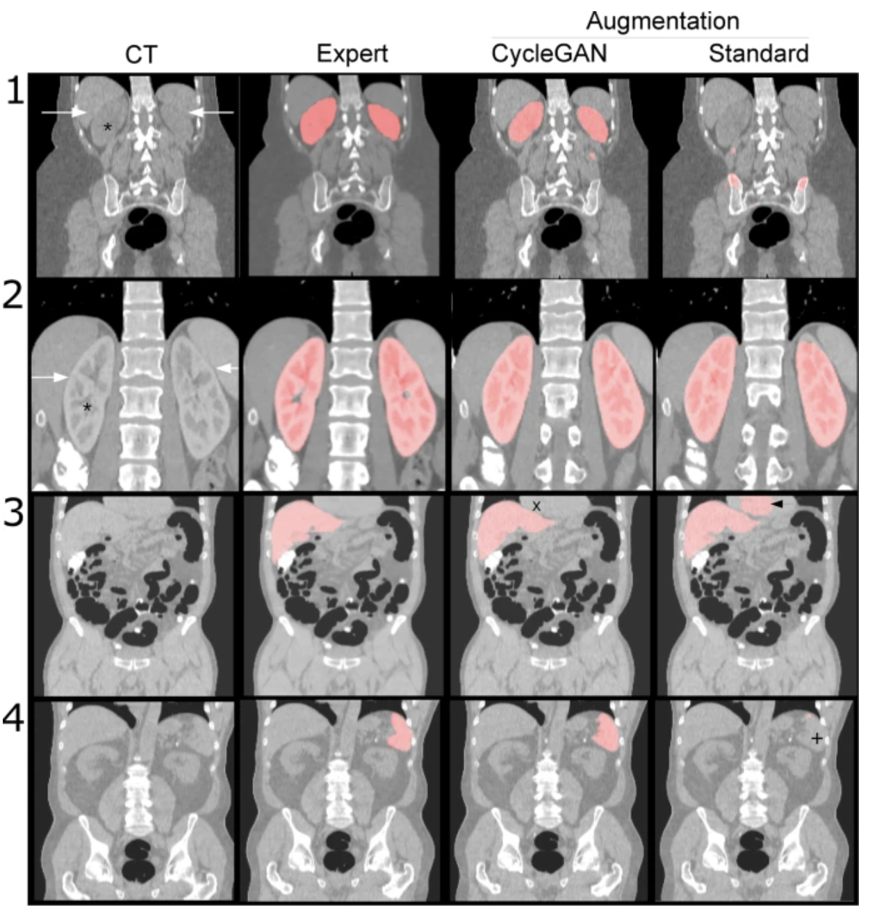
Data augmentation: GAN
Example: kidney segmentation with data augmentation by CycleGAN
Data augmentation using generative adversarial networks (CycleGAN) to improve generalizability in CT segmentation tasks (Sandfort et al., 2019)

Slide 46
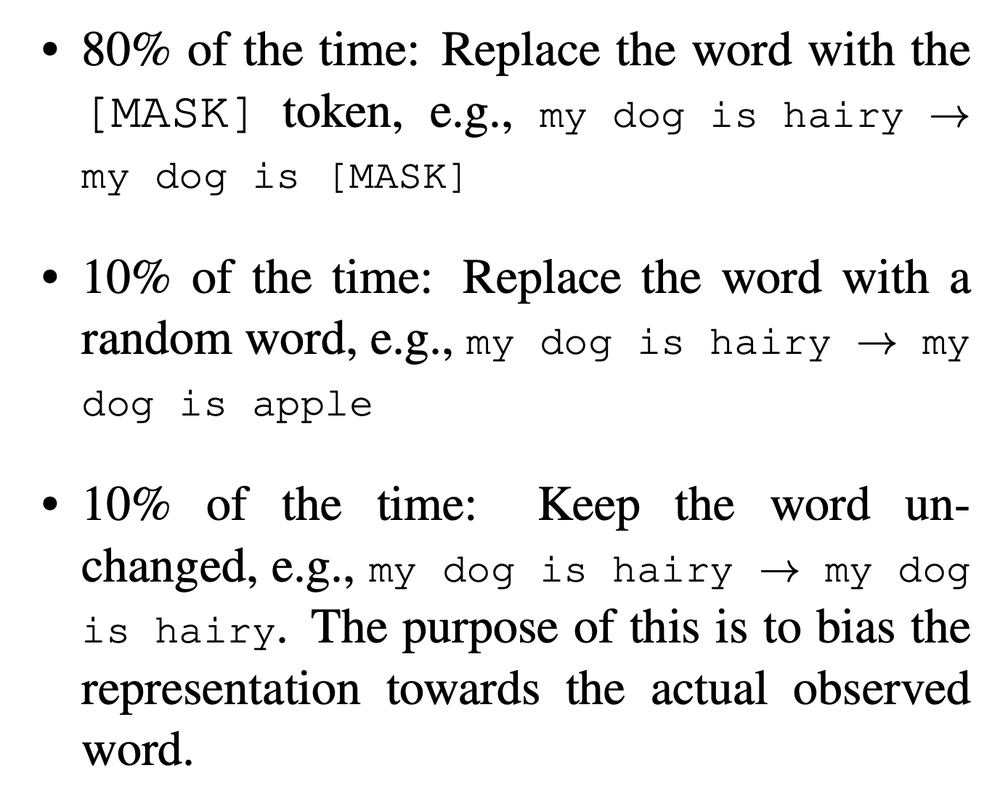
Data augmentation: text
Random replacement
e.g. BERT (10% * 15% = 1.5%)
BERT: Pre-training of Deep Bidirectional Transformers for Language Understanding (Devlin et al., 2018)

Slide 47
Feature engineering

Slide 48
Engineered features vs. learned features
Feature engineering: extract features to use in your model
Isn’t the promise of deep learning is that you won’t have to engineer features?

Slide 49
Engineered features: text
I have a dog. He’s sleeping.
Stopword removal
# features
Lemmatization
I have dog. He’s sleeping.
0 | 3 | 0 | 0 | ...
1 | 0 | 0 | 0 | ...
0 | 0 | 1 | 0 | ..
... | ... | ... | ... | ...
Contraction
I have dog. He’s sleep.
# samples
Classifier
(e.g. LogReg)
Punctuation
I have dog. He is sleep.
Lowercase
I have dog He is sleep
N-gram
i have dog he is sleep
I | you | have | dog | cat | he | she | is | they | sleep | I, have | have, dog | good, dog | ...
1 | 0 | 1 | 1 | 0 | 1 | 0 | 1 | 0 | 1 | 1 | 1 | 0 | ...
Features

Slide 50
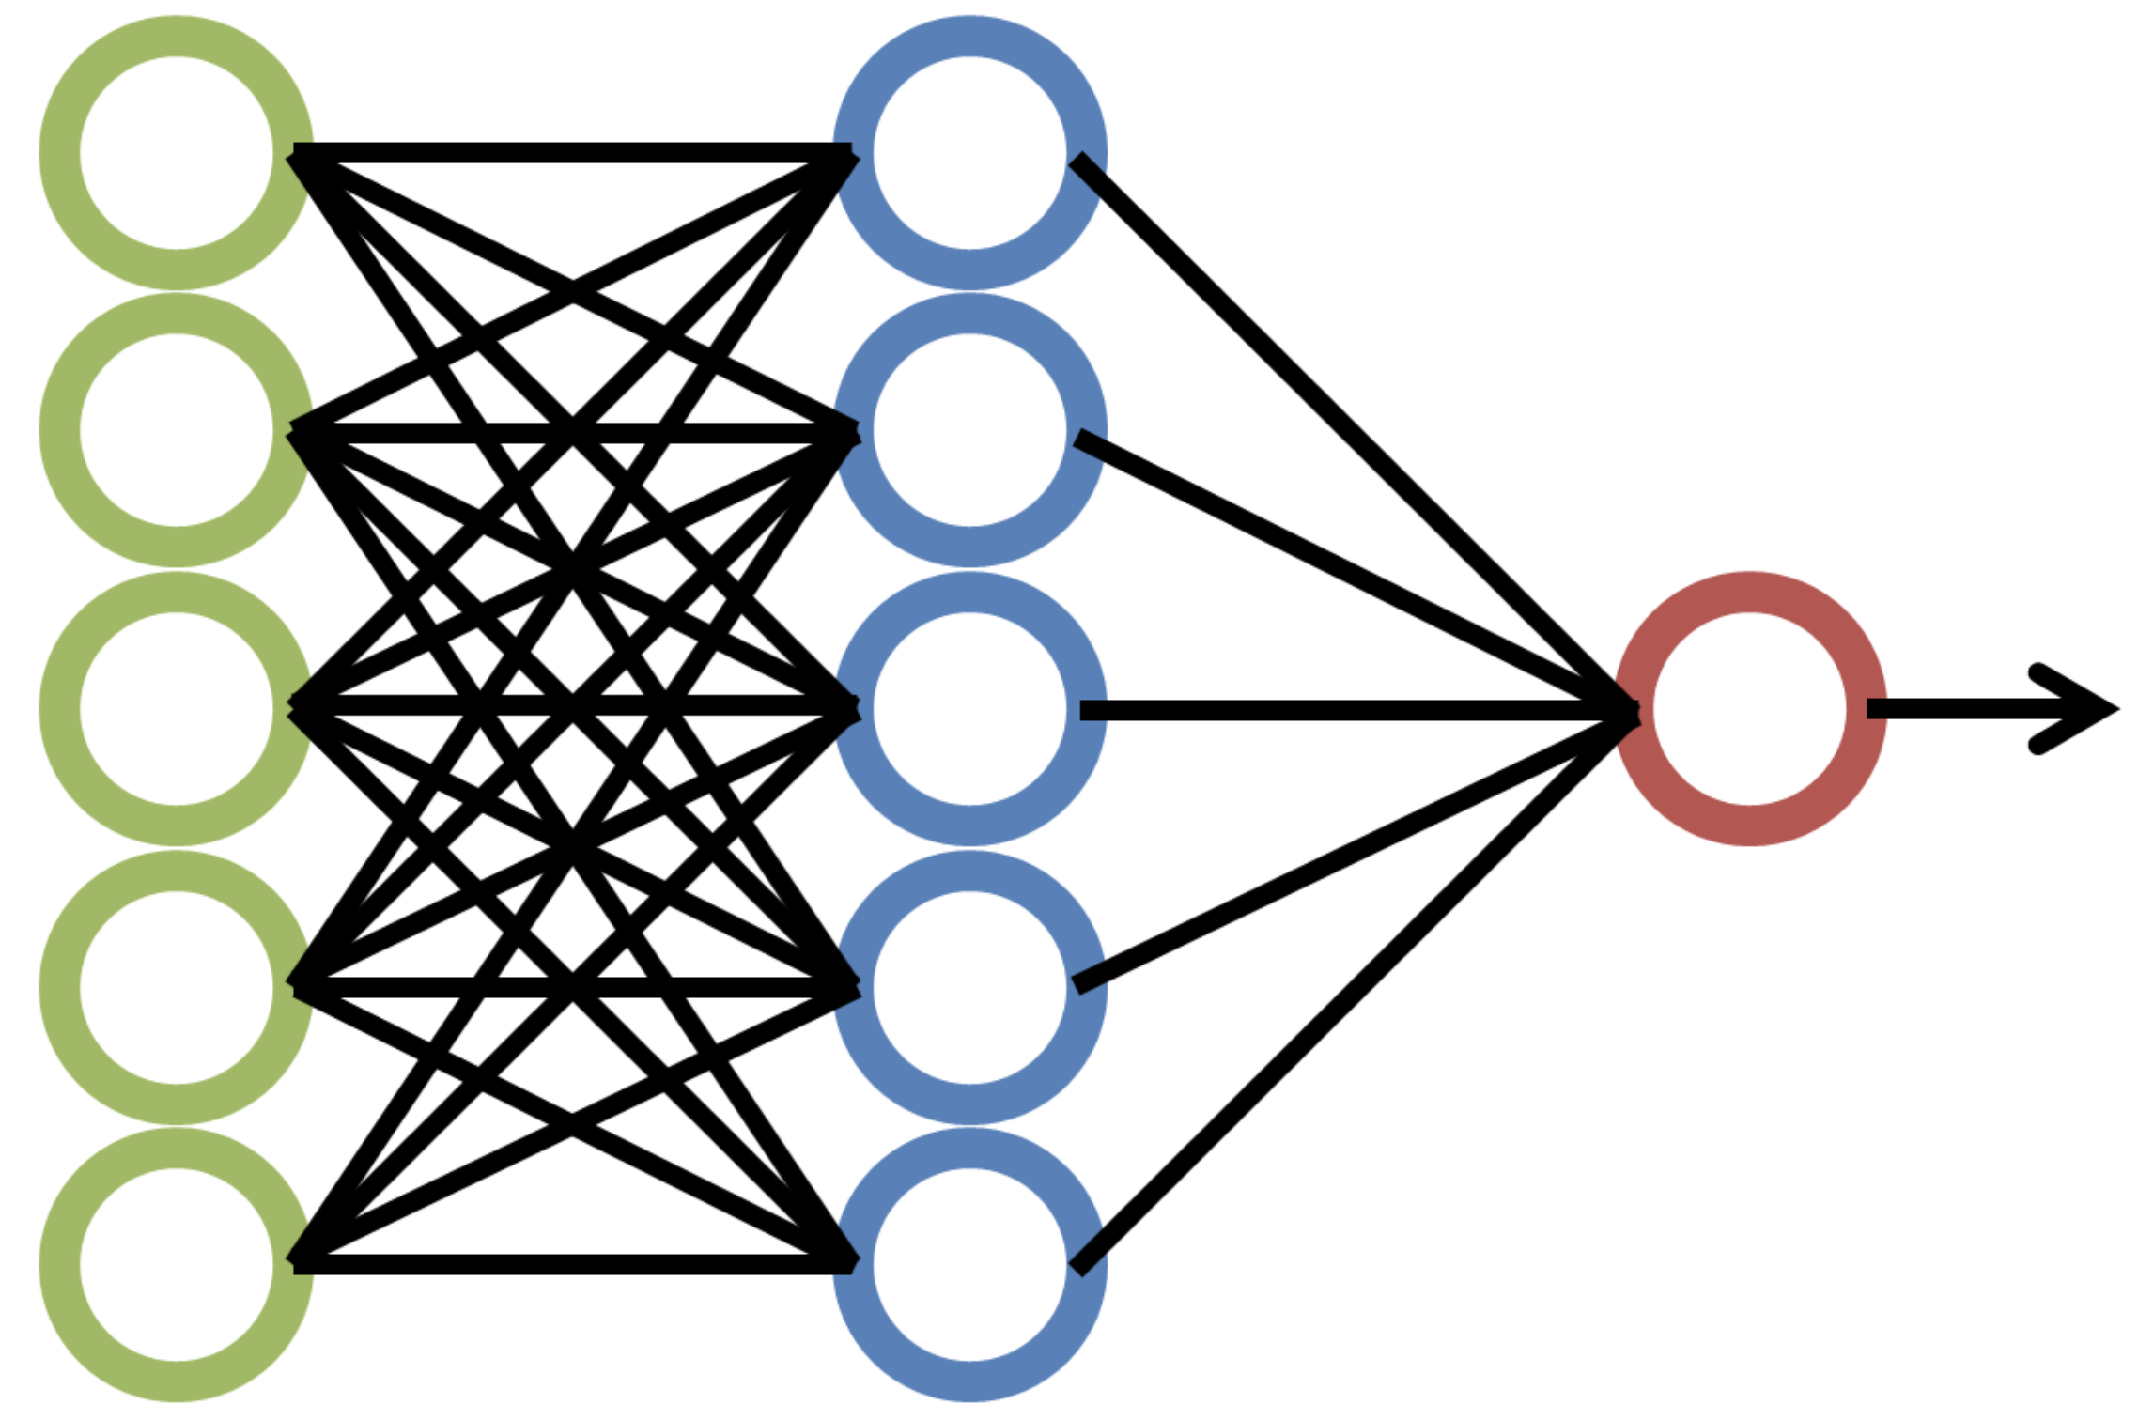
Learned features: text
one-hot encoding
0 | 0 | 0 | 0 | ...
0 | 0 | 0 | 0 | ...
0 | 0 | 1 | 0 | ..
... | ... | ... | ... | ...
# samples
Feature learner
(e.g. embeddings)
Classifier
(e.g. softmax)
Text
I have a dog. He’s sleeping.
One-hot
I | you | have | dog | cat | he | she | is | they | sleep | mom | food | yes | ...
1 | 0 | 1 | 1 | 0 | 1 | 0 | 1 | 0 | 0 | 0 | 0 | 0 | ...

Slide 51
Learned features: spam classification
Comment ID | Time | User | Text | # | # | Link | # images | Thread ID | Reply to | # replies | ...
93880839 | 2020-10-30 T 10:45 UTC | gitrekt | Your mom is a nice lady. | 1 | 0 | 0 | 0 | 2332332 | n0tab0t | 1 | ...
User ID | Created | User | Subs | # | # | # Threads | # replies | Karma | Verified email | Sex | ...
4402903 | 2015-01-57 T 3:09 PST | gitrekt | [r/ml, r/memes, r/socialist] | 15 | 90 | 28 | 776 | 304 | No |  | ...
Thread ID | Time | User | Text | # | # | Link | # images | # replies | # visits | Award | ...
9388320839 | 2020-10-30 T 2:45 PST | doge | Human is temporary, AGI is forever | 120 | 50 | 1 | 0 | 32 | 2405 | 1 | ...

Slide 52
Feature engineering: spam classification
Even more features:
Post frequency, max posts per day
Post repetitiveness
Language detection, typos, abnormal punctuations, ratio uppercase/lowercase
IP, other users from the same IP
NSFW words, blacklisted links
Targeted users
...

Slide 53
Feature engineering
For complex tasks, number of features can go up to millions or billions!
Lots of ML production work involves coming up with new features
Fraudsters come up with new techniques very fast, so need to come up with new features very fast to counter
Often require subject matter expertise

Slide 54
Data leakage
Some form of the label “leaks” into the features
This same information is not available during inference

Slide 55
Data leakage: example 1
Problem: detect lung cancer from CT scans
Data: collected from hospital A
Performs well on test data from hospital A
Performs poorly on test data from hospital B
Patient ID | Date | Doctor note | Medical record | Scanner type | CT scan

Slide 56
Data leakage: example 1
Problem: detect lung cancer from CT scans
Data: collected from hospital A
Performs well on test data from hospital A
Performs poorly on test data from hospital B
Patient ID | Date | Doctor note | Medical record | Scanner type | CT scan
At hospital A, when doctors suspect that a patient has lung cancer, they send that patient to a higher-quality scanner

Slide 57
Data leakage: example 2
Problem: predicting how many views an article will get
Data: historical data on the site
Where might data leakage come from?
Article ID | Date | Title | Article | Author | Language | Translations

Slide 58
Data leakage: example 2
Problem: predicting how popular an article will become
Data: historical data on the site
Not leakage because author popularity also available during inference
Article ID | Date | Title | Article | Author | Language | Translations
The site only translate articles that are already gaining attention

Slide 59
Data leakage
What if leakage is baked into training samples?
Remove all leaked information
Normalization

Slide 60
Types of data leakage
Feature leakage
Training data leakage
Premature featurization: creating feature on the entire data instead of just training data
E.g. create n-gram counts/vocabulary from train + test sets
Oversampling before splits
Train splits might contain test samples
Time leakage
Randomly splitting data instead of temporal split can cause training data to be able to see the future
Group leakage
A patient has 3 CT scans: 2 in train, 1 in test.

Slide 61
How to avoid leakage?
Lots of data exploration and testing!
Check for duplication between train and valid/test splits
Temporal split data (if possible)
Use only train splits for feature engineering: no peak!
Measure correlation between features and labels
Train model on subset of features
If performance very high on a subset, either very good set of features or leakage!
Monitor model performance as more features are added
Sudden increase: either a very good feature or leakage!
Involve subject matter experts in the process

Slide 62
Feature engineering: the more the better?
Adding more features tends to improve model performance

Slide 63
Feature engineering: the more the better?
Adding more features tends to improve model performance
Overfitting
Too many features makes your model different to maintain
The more feature engineering you do, the more chance for labels to leak
Feature A doesn’t cause leakage, but feature A + feature B can cause leakage

Slide 64
Feature engineering: the more the better?
Adding more features tends to improve model performance
Overfitting
Too many features makes your model different to maintain
The more feature engineering you do, the more chance for labels to leak
Feature A doesn’t cause leakage, but feature A + feature B can cause leakage
Clean up features that are no longer relevant
Store them in case you want to reuse them

Slide 65
Model selection & training

Slide 66
Classical ML algorithms
Logistic regression
Very hard to beat baseline
Tree-based models: random forest, bagging, boosting
XGBoost still one of the most popular winning algorithms on Kaggle
K-nearest neighbor
Great for anomaly detection
SVM
...

Slide 67
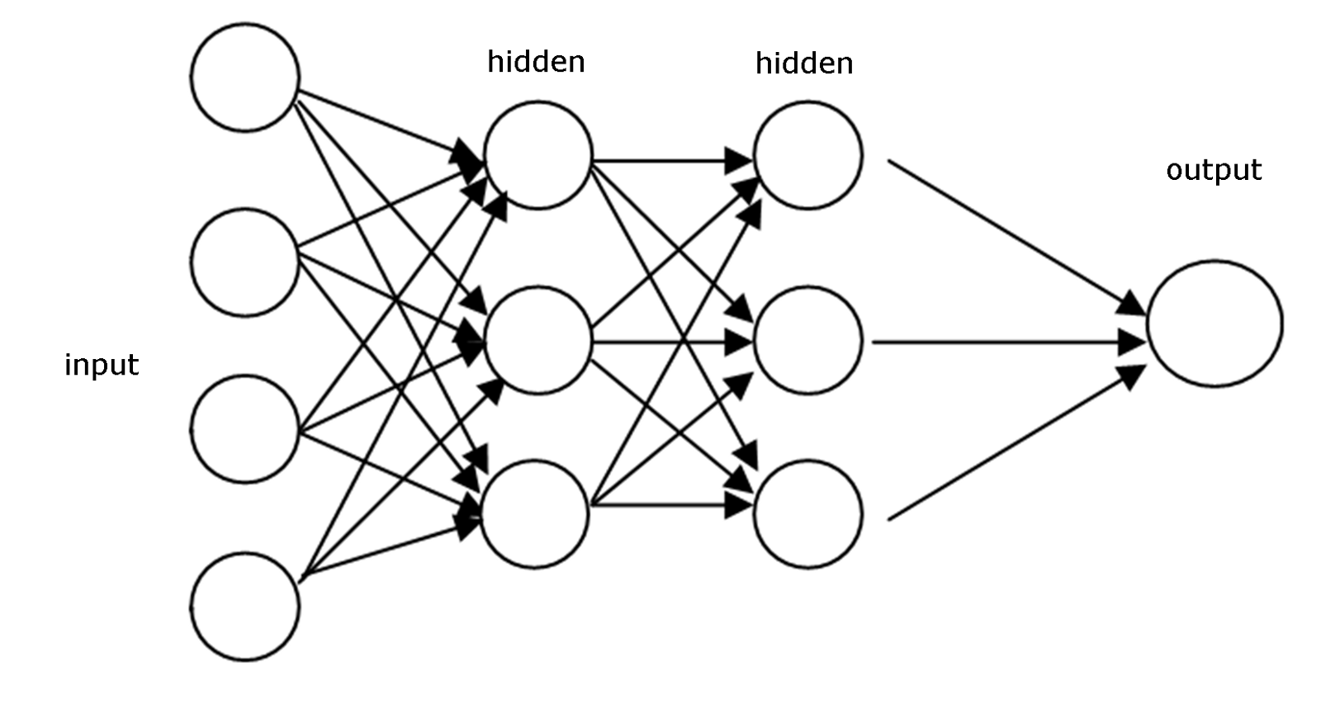
Neural architecture evolution
Feed-forward NNs

Slide 68

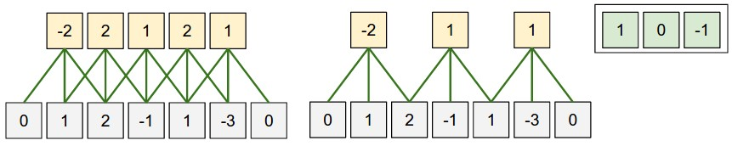
Neural architecture evolution
Instead of connecting each neuron to all input, connect each neuron to a subset of inputs
local information
CNNs
Feed-forward NNs
Left image from http://deeplearning.stanford.edu/, right image from S231N Lecture 7.

Slide 69
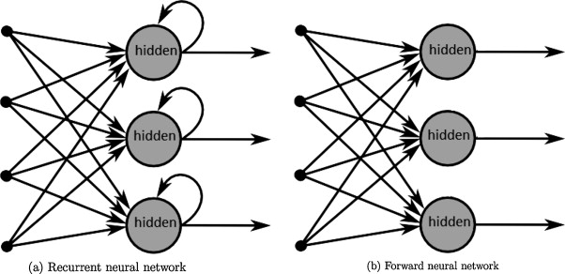
Neural architecture evolution
Instead of using different weights for different timesteps, use same weights!
local information
CNNs
Feed-forward NNs
weights sharing across steps
RNNs
"A survey on the application of recurrent neural networks to statistical language modeling." (De Mulder et al., 2015)

Slide 70

Neural architecture evolution
local information
CNNs
self-attention
Feed-forward NNs
Transformers
weights sharing across steps
RNNs
Allow classifier to peak at all previous hidden states
Attention Is All You Need (Vaswani et al., 2017)

Slide 71
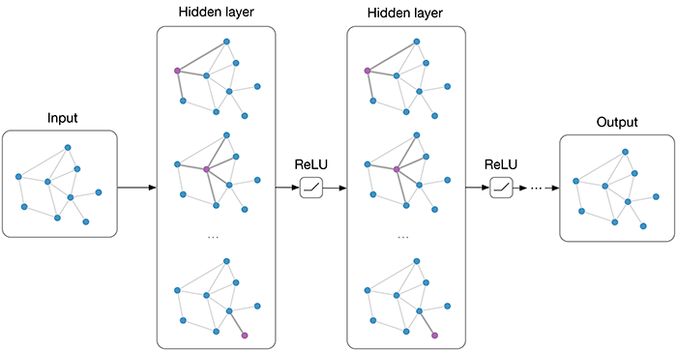
Neural architecture evolution
Graph NNs
CNNs
element relations
local information
self-attention
Feed-forward NNs
Transformers
weights sharing across steps
RNNs
Graphs are natural representations for:
inputs: social networks, knowledge bases, game states
outputs: any joint distribution can be represented as a factor graph
Graph Convolutional Networks (Thomas Kipf, 2016)

Slide 72
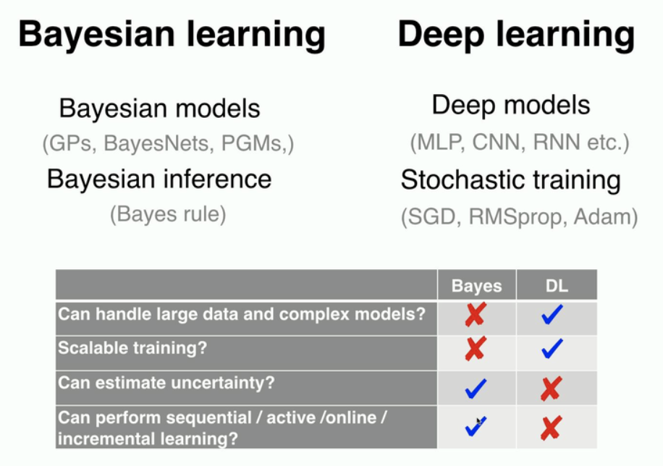
Neural architecture evolution
Graph NNs
CNNs
element relations
local information
self-attention
Feed-forward NNs
Transformers
weights sharing across steps
priors
RNNs
Bayesian NNs
Use a probability distribution over the network weights and output an average prediction of all sets of weights in that distribution
Deep Learning with Bayesian Principles (Emtiyaz Khan, NeurIPS 2019)

Slide 73
Neural architecture evolution
Graph NNs
CNNs
element relations
local information
self-attention
Feed-forward NNs
Transformers
?
weights sharing across steps
priors
RNNs
Bayesian NNs
More weights resharing
Global connections with reduced complexity
More structure (priors)

Slide 74
Architecture evolution
Architectures come and go
LSTM-RNNs: largely replaced by Transformers for text, still used for time series (frequency trading)
Be solution-focused, not architecture/buzzword-focused

Slide 75
Model selection: baselines
Random baseline
Predict at random:
uniform
following same distribution
Zero rule baseline
Predict the most common class always
Human baseline
Human expert?
Simple heuristic:
E.g. autocompletion: predict the character most likely to appear based on a trigram lookup table
Existing solutions:
Existing APIs
Don’t be afraid to generate fake data for baselines!

Slide 76
Model selection: baselines
Random baseline
Predict at random:
uniform
following same distribution
Zero rule baseline
Predict the most common class always
Human baseline
Human expert?
Simple heuristic:
E.g. autocompletion: predict the most character based on a trigram lookup table
Existing solutions:
Existing APIs
Example: misinformation classification
n = 1,000,000
99% negative (label = 0)
1% positive (label = 1)
 | Accuracy | F1
Uniform random | 0.5 | 0.02
Distribution random | 0.98 | 0.01
Most common (preds = [0] * n) | ? | ?

Slide 77
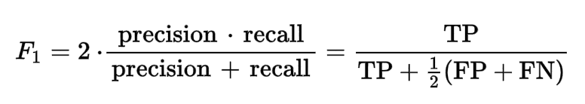
Model selection: baselines
Random baseline
Predict at random:
uniform
following same distribution
Zero rule baseline
Predict the most common class always
Human baseline
Human expert?
Simple heuristic:
E.g. autocompletion: predict the most character based on a trigram lookup table
Existing solutions:
Existing APIs
Example: misinformation classification
n = 1,000,000
99% negative (label = 0)
1% positive (label = 1)
 | Accuracy | F1
Uniform random | 0.5 | 0.02
Distribution random | 0.98 | 0.01
Most common (preds = [0] * n) | 0.99 | NaN

Slide 78
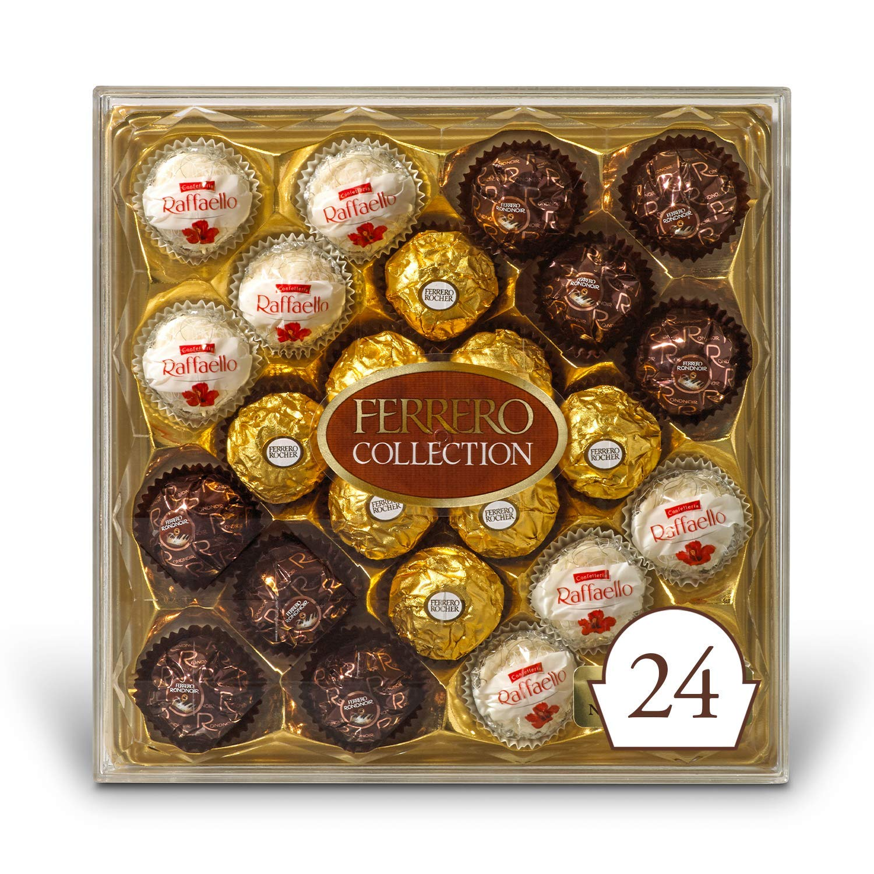
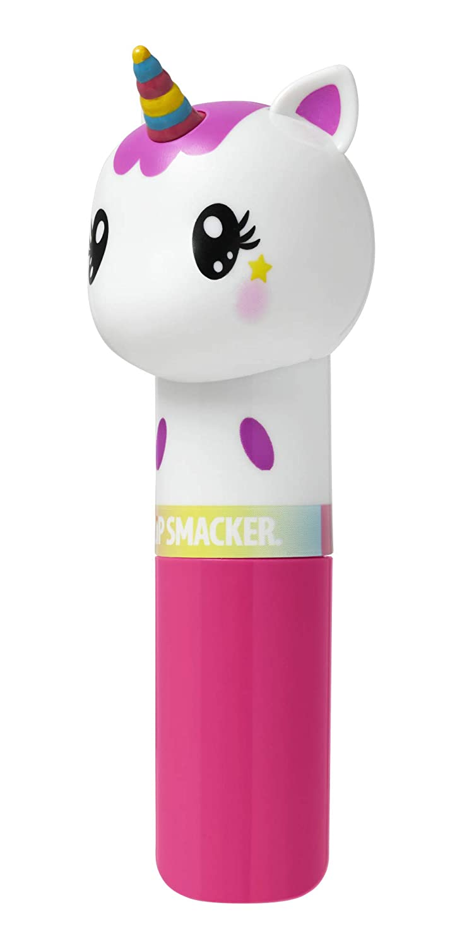

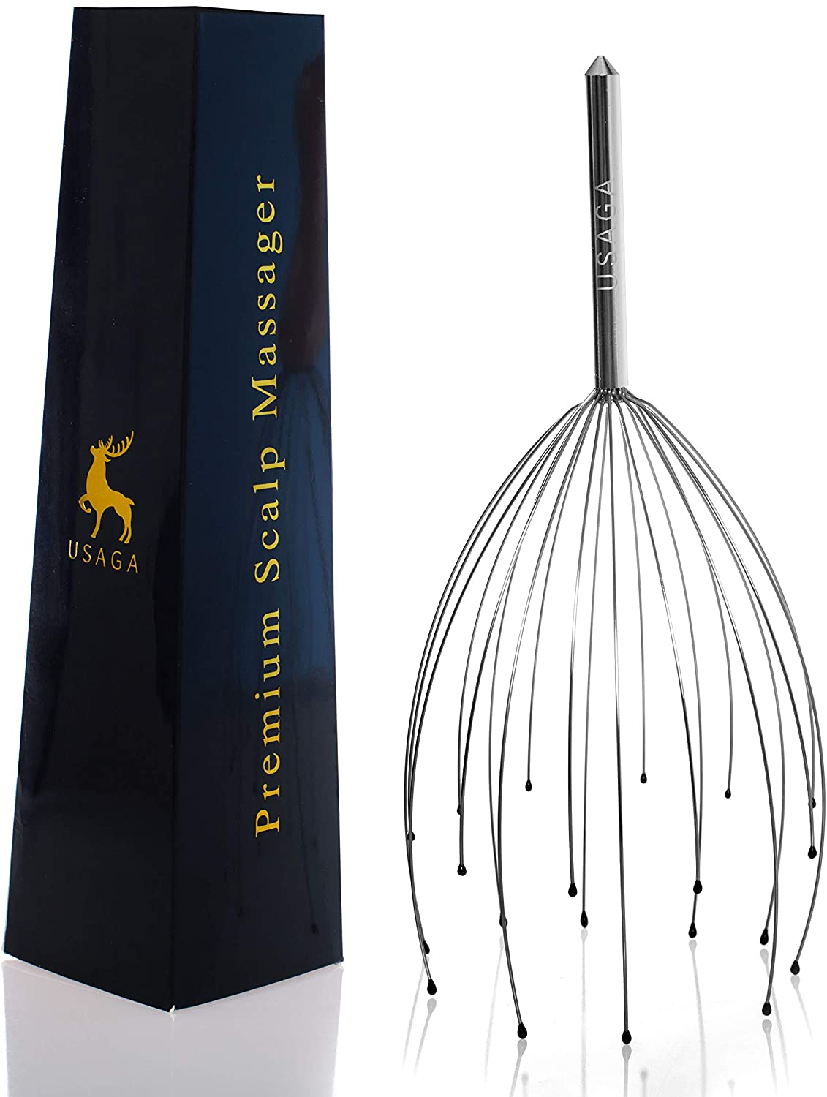

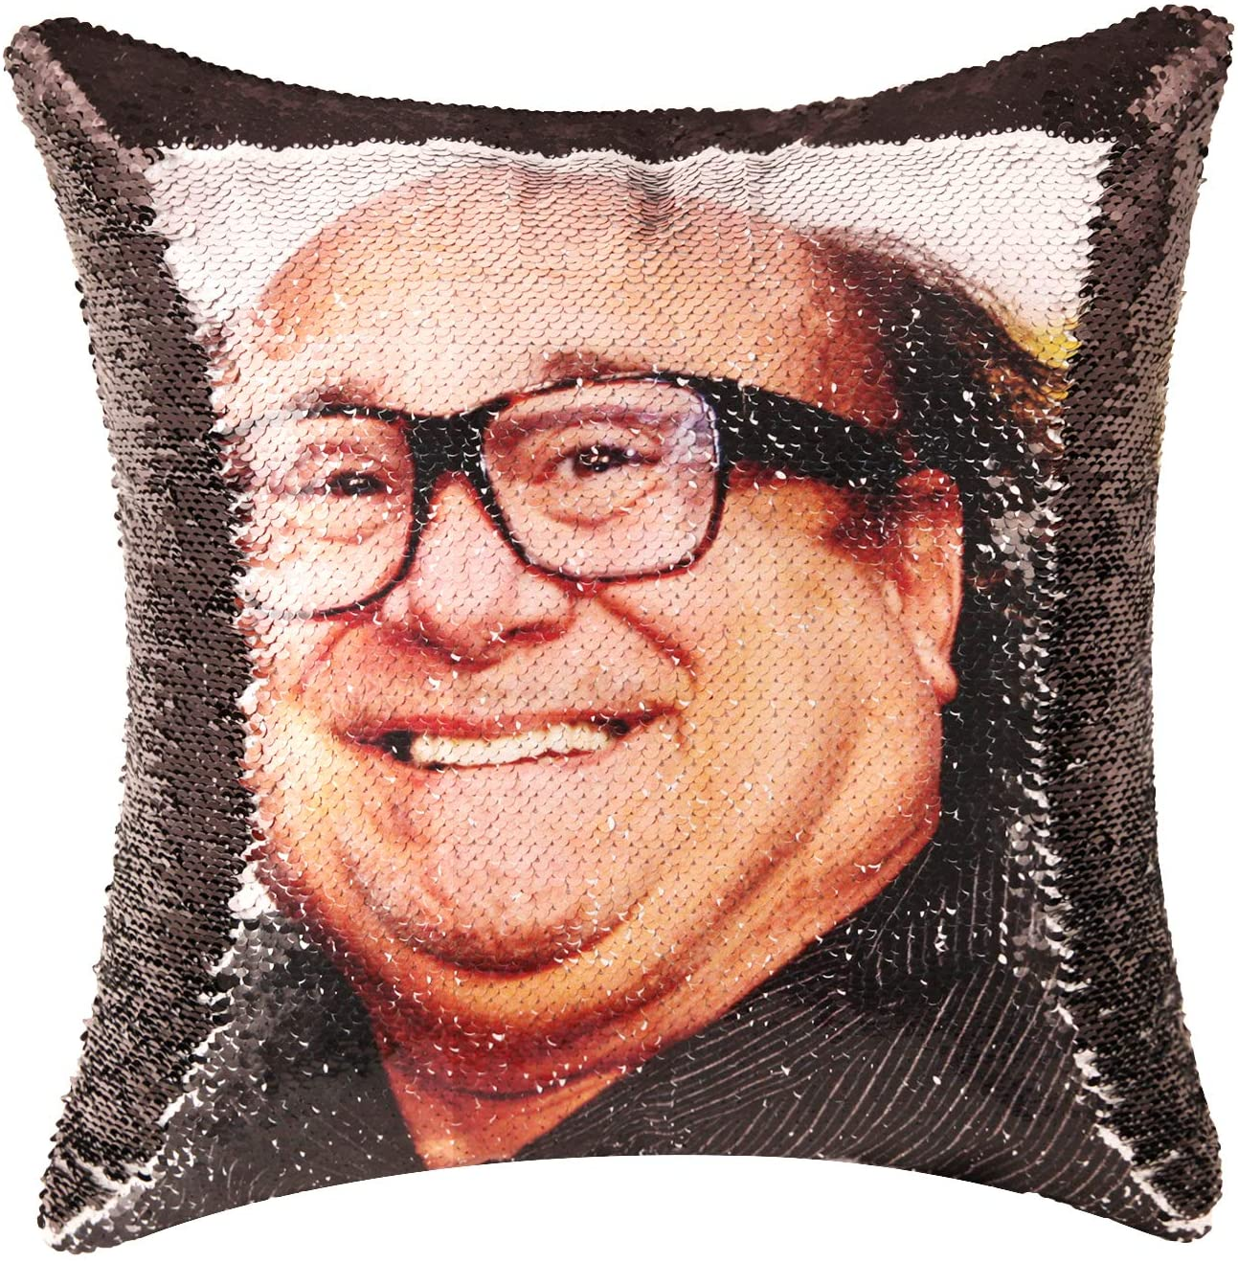
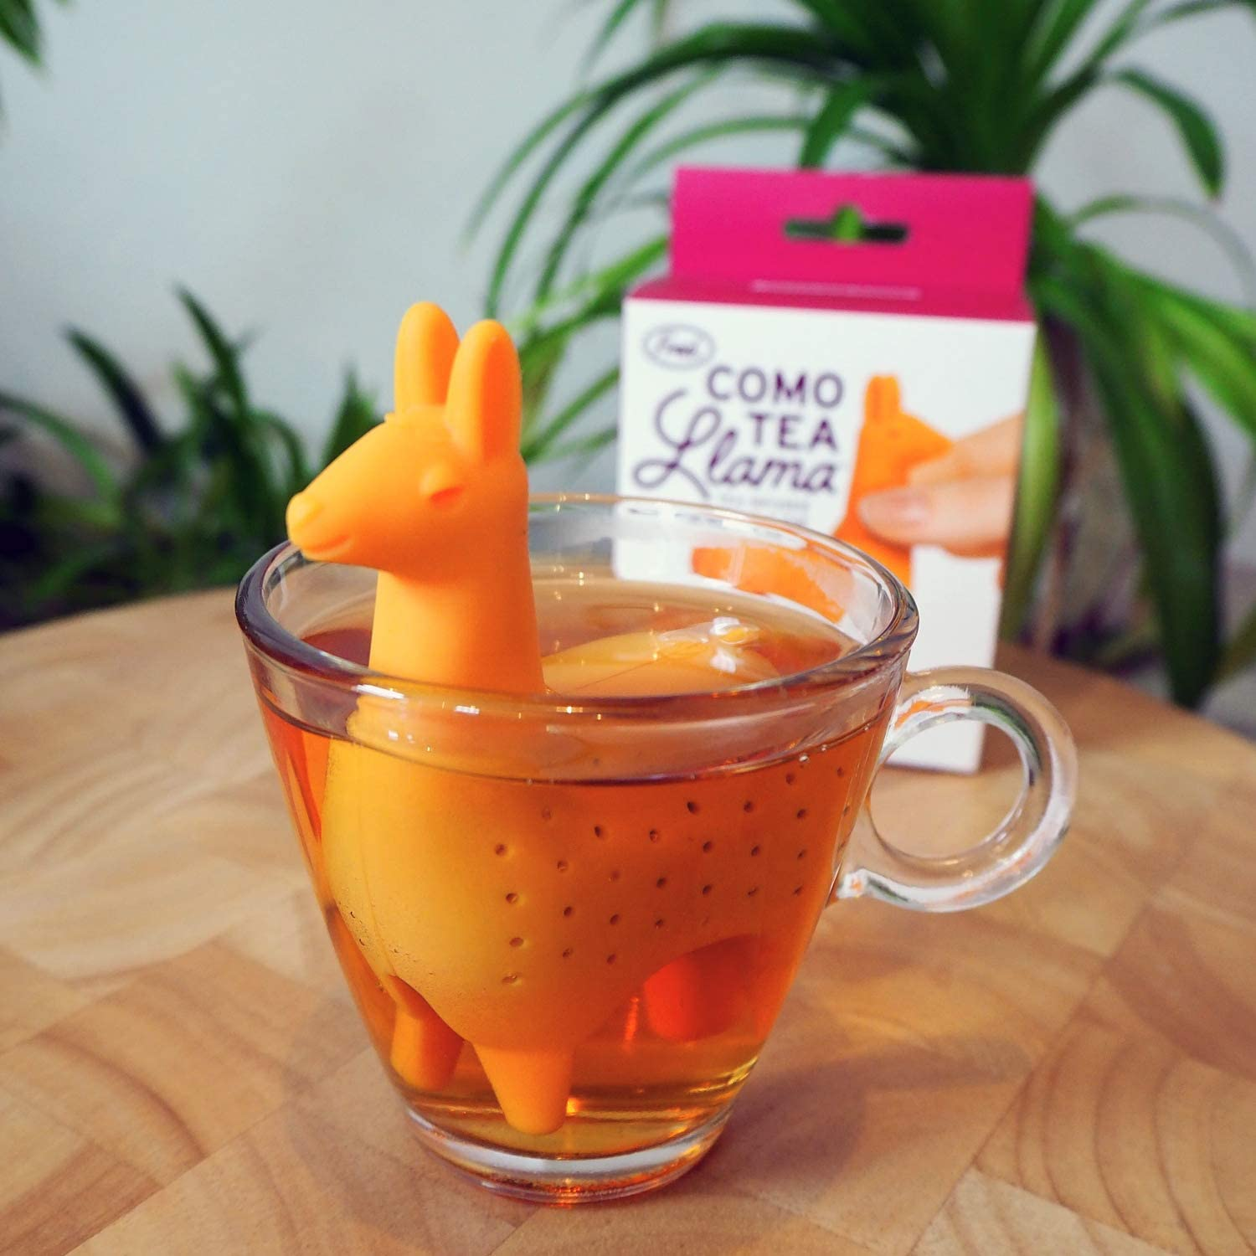
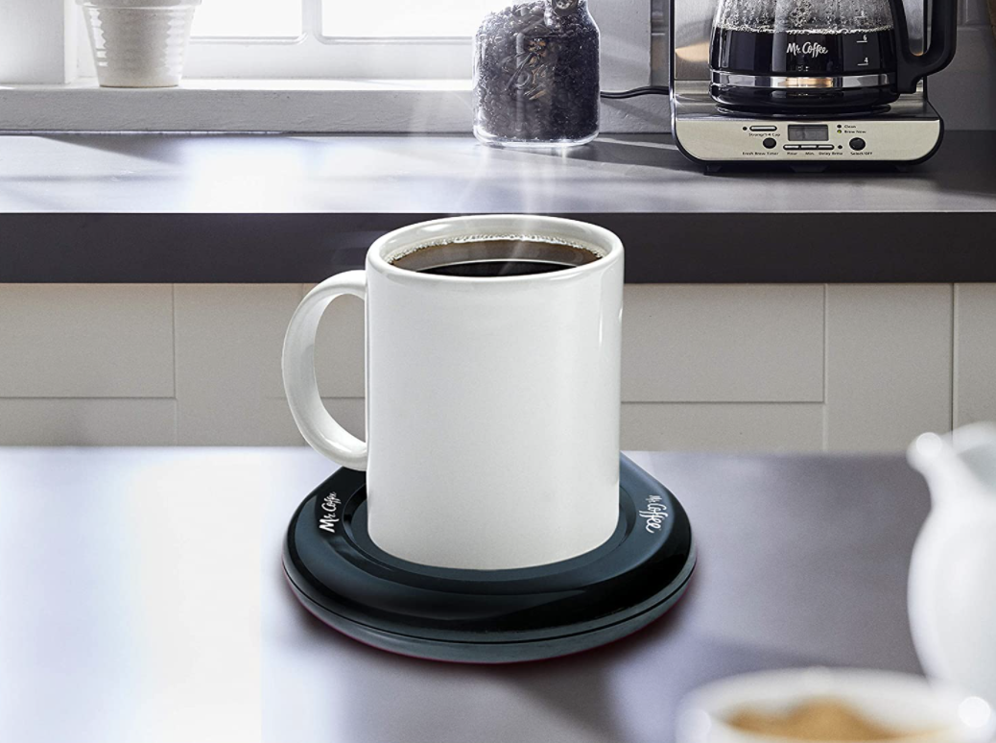

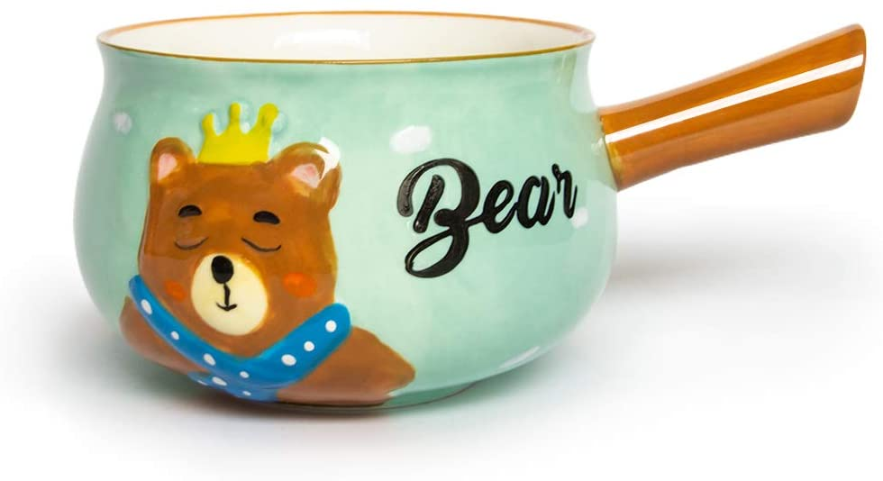
1 2 9 4 5
3 6 7 8 10

Slide 79
Machine Learning Systems Design
Next class: Distributed training & framework tutorials
cs329s.stanford.edu | Chip Huyen

